Slide 1
Lesson #4 Advanced Copy Editing: Accuracy, Style, and Fact-Checking
Olasunkanmi Arowolo, PhD
Notes:
The Cost of One Error
Imagine a news report is published stating that a university received ₦500 million in funding. Within hours, the story spreads across social media. Students celebrate. Administrators respond. Public expectations rise.
The next day, a correction is issued.
The actual figure was ₦50 million.
Not a small mistake. A zero too many.
But by then:
The misinformation has spread
Trust has been weakened
The credibility of the media organisation is questioned
This is the reality of editing.
One unchecked detail can distort reality.
Today’s focus is simple: An editor’s most important responsibility is not grammar. It is truth.
This builds directly on Week 3 and deepens students’ ability to move from basic correction to professional editorial judgement.

Slide 2
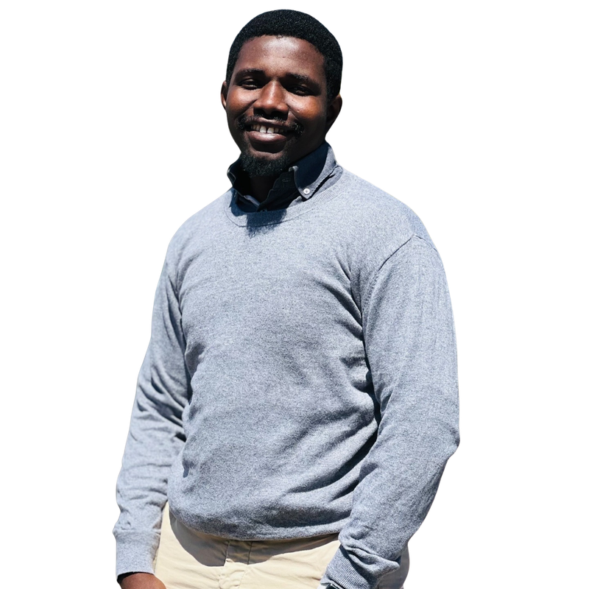
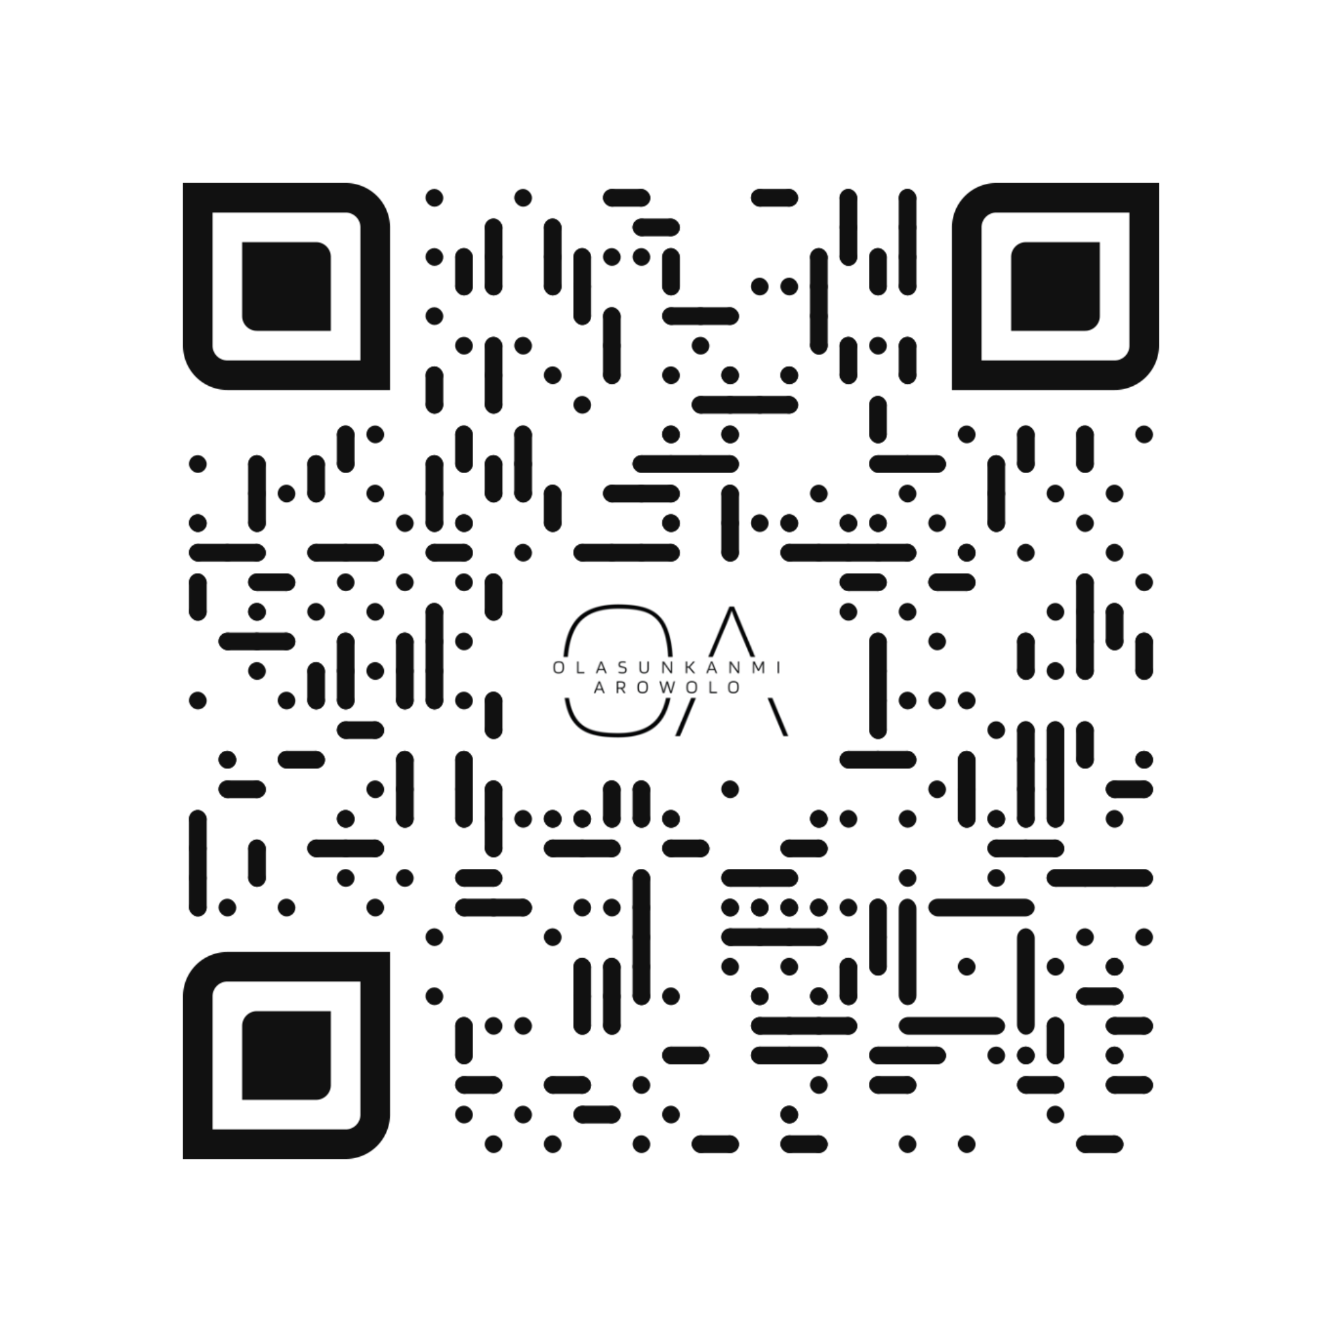
Dr. Olasunkanmi Arowolo
Journalism, Political & Development Communications Scholar

Slide 3
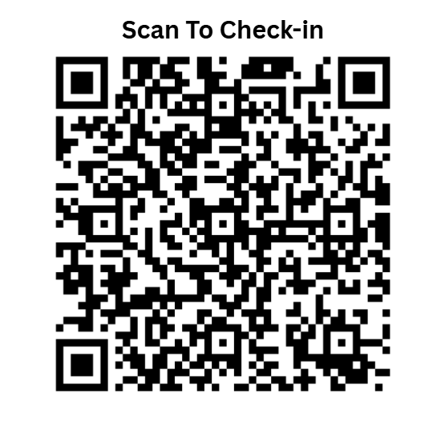
QuickQuestions
Get started here

Slide 4
What We Will Cover Today
Accuracy in Editing
Fact-Checking Techniques
Style Guides and Consistency
Eliminating Bias and Ambiguity
Practical Editing Applications
Notes:
Frame the lecture as both foundational and professionally relevant.

Slide 5
Objectives
By the end of this session, you should be able to:
Explain how content moves through a newsroom
Identify the role of a sub-editor
Apply basic editing and proofreading symbols
Understand how editing decisions shape final output
Notes:
Apply advanced copy editing principles Verify facts and detect inaccuracies Maintain consistency using style rules Identify bias and ambiguity in writing Improve editorial judgement

Slide 6
Beyond Basic Editing
What Makes Editing “Advanced”?
Moving beyond grammar correction
Focusing on truth, clarity, and fairness
Making editorial decisions, not just corrections
Notes:
Lecturer Note (Framing)
Ask: “Is a grammatically correct sentence always a good sentence?”

Slide 7
Accuracy in Editing
The Principle of Accuracy
Every fact must be correct
Names, dates, figures, and locations must be verified
Small errors damage credibility

Slide 8
Example
Incorrect: “FG allocates ₦3 million to education sector”
Correct: “FG allocates ₦3 billion to education sector”

Slide 9
Fact-Checking Fundamentals
What is Fact-Checking?
The process of verifying information before publication
What to Check:
Names
Dates
Statistics
Quotes
Sources

Slide 10
Fact-Checking Techniques
How to Verify Information
Cross-check multiple sources
Use official data sources
Confirm quotes and attribution
Avoid assumptions
Notes:
C. Accuracy D. Design

Slide 11
Common Fact Errors
Typical Mistakes
Wrong figures
Misquoted statements
Incorrect names or titles
Outdated information

Slide 12
What is the primary purpose of fact-checking in editing?
To improve sentence length
To ensure information is accurate and verifiable
To make headlines more attractive
To reduce writing time
© Olasunkanmi Arowolo

Slide 13
What is the primary purpose of fact-checking in editing?
To improve sentence length
To ensure information is accurate and verifiable
To make headlines more attractive
To reduce writing time
© Olasunkanmi Arowolo

Slide 14
Style and Consistency
Why Style Matters
Ensures uniformity across content
Improves readability
Reflects professionalism

Slide 15
Elements of Style
Key Style Components
Capitalisation
Numbers and figures
Dates and time
Abbreviations

Slide 16
Example of Inconsistency
Inconsistent Writing
“Nigerian Government”
“federal government”
“FG”
Notes:
Problem: Lack of uniformity
Quick task:
Standardise inconsistent terms

Slide 17
Standardise inconsistent terms

Slide 18
Eliminating Ambiguity
Clarity in Meaning
Ambiguous sentence: “Students discussed issues with teachers”
Question: Who has the issues?
Notes:
Expected Responses
Students may suggest:
Correct grammar
Verify facts
Rewrite headline
Correct Priority (Guide Them Towards This)
Fact-checking (accuracy comes first)
Clarity and structure
Grammar and style
Headline refinement
Key Teaching Point
Editing is not random. It is a prioritised decision-making process.
Lecturer Strategy
Push students beyond surface answers:
Ask: “Why not start with grammar?”
Lead them to understand that accuracy outweighs appearance

Slide 19
Removing Bias
Editorial Neutrality
Biased: “The government failed again to fix education problems”
Neutral: “The government has not resolved ongoing education challenges”
Notes:
Ask:
“Is this sentence neutral or biased?”

Slide 20
Ethical Editing
Ethics in Editing
Avoid distortion of facts
Maintain fairness
Respect sources
Notes:
Lecturer Prompt
Ask:
“Which of these qualities do you already have, and which do you need to develop?”

Slide 21
Practical Example
Edit for Accuracy and Clarity
Flawed paragraph with: Incorrect data, Ambiguity, Bias
The Lagos State University yesterday announce that they have introduce a new policy to improve students academic performance but many of the student complains that the policy is not clear and the management have not properly communicated it to them, some lecturers was also confuse about how to implement the changes which has lead to misunderstanding across different department in the school and this situation is affecting the smooth running of academic activities in the institution.

Slide 22
What is the first priority in advanced editing?
Style
Speed
Accuracy
Design
© Olasunkanmi Arowolo

Slide 23
What is the first priority in advanced editing?
Style
Speed
Accuracy
Design
© Olasunkanmi Arowolo

Slide 24
Class Activity
Fact-Checking Exercise
Provide a short article
Students identify:
Possible inaccuracies
Missing verification points

Slide 25
Short Article (Intentionally Flawed)
The Lagos State University (LASU) recently ranked as the number one university in Africa according to a global education report released last week. The Vice-Chancellor stated that the university has received over ₦200 billion in funding from the federal government to improve infrastructure and research output.
Students have also confirmed that all faculties in the institution are now fully equipped with digital learning facilities, making LASU the most technologically advanced university in Nigeria. According to reports, over 95% of graduates from the university secure employment within three months of graduation.
In addition, the university management announced that international students from over 50 countries are currently enrolled, further strengthening its global reputation.
Notes:
EXPECTED STUDENT FINDINGS (FOR YOU AS LECTURER)
Possible Inaccuracies
“Number one university in Africa” → highly questionable, no source cited
“₦200 billion funding” → likely exaggerated or incorrect
“All faculties fully equipped” → unrealistic generalisation
“95% employment within three months” → requires strong evidence
Missing Verification Points
What “global education report”?
Which organisation released it?
Where is the funding data from?
Who confirmed student claims?
Source for employment statistics?
Evidence for “50 countries” claim?
Weak Language Indicators
“According to reports” → vague
“Students have confirmed” → not credible sourcing
“Recently” → lacks specificity
FOLLOW-UP DISCUSSION QUESTIONS
Which claim is the most dangerous if published unverified?
Which statement appears most believable but may still be false?
How would you verify one of these claims?
TEACHING INSIGHT
The most dangerous errors are not obvious mistakes. They are confidently written falsehoods.

Slide 26
Which of the following is a strong indicator that a statement may be unreliable?
It includes specific dates
It is supported by official sources
It uses vague phrases like “according to reports”
It includes names of institutions
© Olasunkanmi Arowolo

Slide 27
Which of the following is a strong indicator that a statement may be unreliable?
It includes specific dates
It is supported by official sources
It uses vague phrases like “according to reports”
It includes names of institutions
© Olasunkanmi Arowolo

Slide 28
Corrected Copy (Edits Highlighted in Bold)
The Lagos State University (LASU) was reportedly ranked among leading universities in Africa according to an unspecified global education report released last week. The Vice-Chancellor stated that the university has received funding support from the federal government to improve infrastructure and research output.
Some students indicated that several faculties in the institution are now equipped with digital learning facilities, contributing to improvements in teaching and learning. However, no official data confirms that LASU is the most technologically advanced university in Nigeria. According to unverified reports, a proportion of graduates from the university secure employment within a few months of graduation.
In addition, the university management announced that international students from multiple countries are currently enrolled, although the exact number of countries was not specified, further strengthening its global reputation.
Notes:
Lecturer Note (How to Explain This)
Highlight how:
Absolutes were softened (e.g. “number one” → “among leading”)
Unverified claims were flagged
Vague sources were made explicit as weak
Certainty was replaced with evidence-aware language
Key Teaching Point
Good editing does not invent facts. It removes false certainty and restores credibility.

Slide 29
What is the most appropriate editorial response to an unverified statistical claim?
Replace it with a confirmed or clearly qualified statement
Remove it completely without review
Publish it with emphasis
Ignore it if it sounds correct
© Olasunkanmi Arowolo

Slide 30
What is the most appropriate editorial response to an unverified statistical claim?
Replace it with a confirmed or clearly qualified statement
Remove it completely without review
Publish it with emphasis
Ignore it if it sounds correct
© Olasunkanmi Arowolo

Slide 31
Key Takeaways
Summary
Editing is about truth, not just grammar
Fact-checking is essential
Consistency improves professionalism
Editors must avoid bias

Slide 32
Assignment
Edit a provided article
Identify:
5 factual issues
3 style inconsistencies
2 ambiguous statements

Slide 33
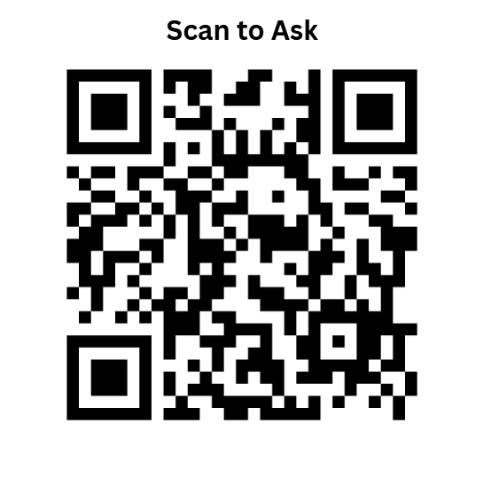
Questions & Next Steps
Any Questions?

Slide 34
Preview of Next Class
Photo Editing Techniques
Visual Framing and Ethics
Introduction to Layout Design

Slide 35

Scan to check-out

